Slide 1


Victor Eduardo Cauvilla de Oliveira
10-03-2023

Slide 2

Outline
Executive Summary
Introduction
Methodology
Results
Conclusion
Appendix

Slide 3
Executive Summary
Summary methodologies
Data collection with SpaceX API
Data collection with Web Scraping
Data Wrangling
Exploratory Data Analysis (EDA) using SQL
EDA using Data Visualization
Interactive Visual Analytics with Folium and Dash
Predictive Analysis with Machine L:earning
Summary of results
Exploratory data analysis results
Interactive analytics demo in screenshots
Predictive analysis results

Slide 4
Introduction
Project background and context
Space X advertises Falcon 9 rocket launches on its website with a cost of 62 million dollars; other providers cost upward of 165 million dollars each, much of the savings is because Space X can reuse the first stage. Therefore, if we can determine if the first stage will land, we can determine the cost of a launch. This information can be used if an alternate company wants to bid against space X for a rocket launch. The objective of this project is to create a machine learning pipeline to predict if the first stage will land successfully.
Problems you want to find answers
What factors determine if the rocket will land successfully?
The interaction amongst various features that determine the success rate of a successful landing.
What operating conditions needs to be in place to ensure a successful landing program.

Slide 5

Section 1

Slide 6
Methodology
Executive Summary
Data collection methodology:
Data was obtained using SpaceX API and web-scraping from Wikipedia
Perform data wrangling
One-hot encoding was done on categorical features.
Perform exploratory data analysis (EDA) using visualization and SQL
Perform interactive visual analytics using Folium and Plotly Dash
Perform predictive analysis using classification models
Logistic Regression, SVM, Decision Tree and KNN models were used
Hyperparameters were turned using GridSearch cross-validation
Accuracy on test data was calculated using score method and confusion matrix was plotted.

Slide 7
Data Collection
Following steps were involved in Data Collection:
SpaceX API:
Data was collected by sending GET request to SpaceX API
The data was decoded as json using .json() and turned into a DataFrame using .json_normalize()
The data was then cleaned, missing values were identified and filled where necessary.
Web-Scraping:
Falcon 9 launch records were also collected by web-scraping from Wikipedia
A HTTP GET request was sent to Falcon 9 launch HTML page
The data was parsed and stored as a DataFrame using BeatifulSoup

Slide 8
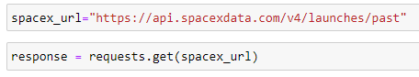
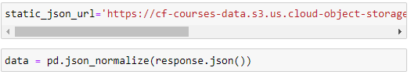
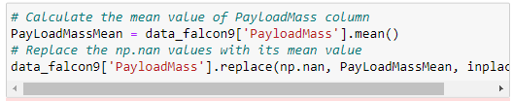
Data Collection – SpaceX API
A GET request was sent to the SpaceX API.
The data was decoded using .json() and converted to DataFrame using .json_normalize()
GitHub Link: https://github.com/Falkenus/IBM-DataScienceFiles/blob/main/Applied%20Data%20Science%20Capstone/jupyter-labs-spacex-data-collection-api.ipynb
1 – GET Request to SpaceX API
2 – Decoding using .json() and converted to a DataFrame using .json_normalize()
3 – Data Cleaning and Dealing with Missing Values

Slide 9
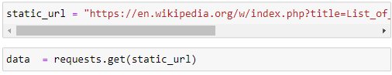
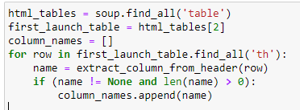
Data Collection - Scraping
HTTP GET request was sent to Falcon 9 Launch HTML Page
Data was parsed and stored as DataFrama using BeautifulSoup
GitHub Link: https://github.com/Falkenus/IBM-DataScienceFiles/blob/main/Applied%20Data%20Science%20Capstone/jupyter-labs-webscraping.ipynb
1 – HTTP GET request to SpaceX Falcon 9 Launch HTML Page
2 – BeautifulSoup Object
3 – Extract all column/variable names from the HTML table header

Slide 10
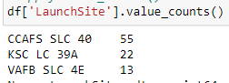
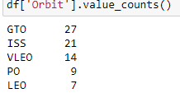
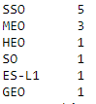
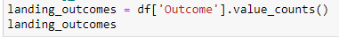
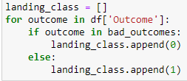
Data Wrangling
Calculated the number of launches on each site, the number and occurrence of each orbit, and types and respective number of landing outcomes
Crated a landing outcome label from the Outcome column
GitHub Link: https://github.com/Falkenus/IBM-DataScienceFiles/blob/main/Applied%20Data%20Science%20Capstone/labs-jupyter-spacex-Data%20wrangling.ipynb
1 – Number of launches on each site
2 – Number and Occurrence of each orbit
3 – Types and number of landing outcomes
4 – Landing column label from Outcome Column

Slide 11
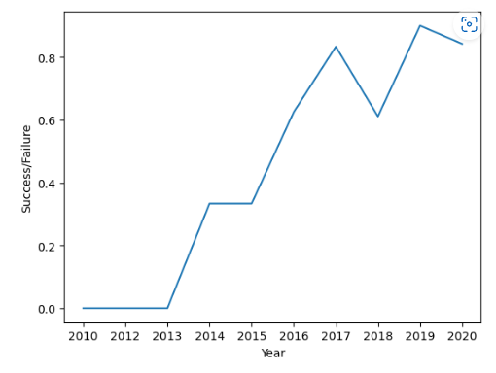
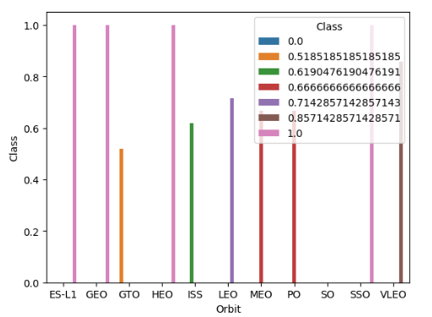
EDA with Data Visualization
We visualized the relationship between flight number and launch site, payload and launch site, success rate and orbit, number of flights and orbit, payload mass and orbit, and launch success yearly trend
GitHub Link: https://github.com/Falkenus/IBM-DataScienceFiles/blob/main/Applied%20Data%20Science%20Capstone/jupyter-labs-eda-dataviz.ipynb

Slide 12
EDA with SQL
SQL table was loaded in Jupyter and following SQL queries were performed:
The names of unique launch sites in the space mission
The total payload mass carried by boosters launched by NASA (CRS)
The average payload mass carried by booster version F9 v1.1
The total number of successful and failure mission outcomes
The failed lading outcomes in drone ship, their booster version and launch site names
GitHub Link: https://github.com/Falkenus/IBM-DataScienceFiles/blob/main/Applied%20Data%20Science%20Capstone/jupyter-labs-eda-sql-coursera.ipynb

Slide 13
Build an Interactive Map with Folium
We marked all launch sites, and added map objects such as markers, circles, lines to mark the success or failure of launches for each site on the folium map.
We assigned the feature launch outcomes (failure or success) to class 0 and 1.i.e., 0 for failure, and 1 for success.
Using the color-labeled marker clusters, we identified which launch sites have relatively high success rate.
We calculated the distances between the launch site and its proximities like railways, highways, and cities.
GitHub Link: https://github.com/Falkenus/IBM-DataScienceFiles/blob/main/Applied%20Data%20Science%20Capstone/lab_jupyter_launch_site_location.ipynb

Slide 14
Build a Dashboard with Plotly Dash
We built an interactive dashboard with Plotly dash
We plotted pie charts showing the total launches by a certain sites
We plotted scatter graph showing the relationship with Outcome and Payload Mass (Kg) for the different booster version.
GitHub Link: https://github.com/Falkenus/IBM-DataScienceFiles/blob/main/Applied%20Data%20Science%20Capstone/spacex_dash_app.py

Slide 15
Predictive Analysis (Classification)
We split the dataset into training and testing set.
We built different machine learning models and tuned different hyperparameters using GridSearchCV.
We used accuracy as the metric for our model and improved the model using feature engineering and hyperparameter tuning.
We found the best performing classification model.
GitHub Link: https://github.com/Falkenus/IBM-DataScienceFiles/blob/main/Applied%20Data%20Science%20Capstone/SpaceX_Machine%20Learning%20Prediction_Part_5.ipynb

Slide 16
Results
Exploratory data analysis results
Interactive analytics demo in screenshots
Predictive analysis results

Slide 17

Section 2

Slide 18
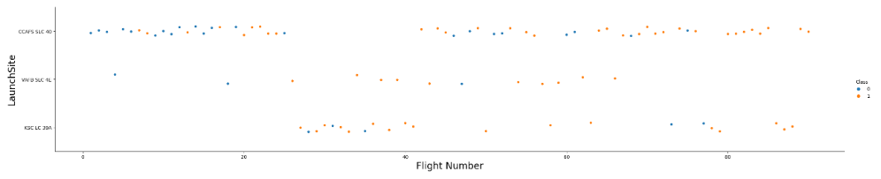
Flight Number vs. Launch Site
From the scatter plot of Flight Number vs. Launch Site we see that greater the number of flights at a launch site, greater is the success rate at the launch site.

Slide 19
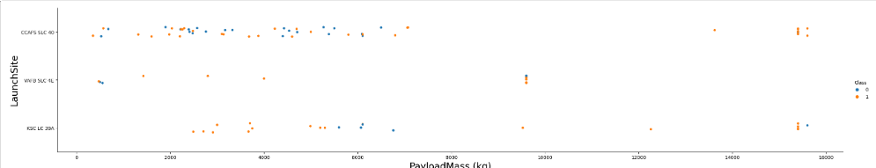
Payload vs. Launch Site
For CCSFS SLC 40, as payload mass increase the first stage is more likely to land.
For VAFB-SLC launch site there are no rockets launched for payload > 10,000 kg
For KDC LC 39A launch site there are no rockets launched for payload < 2,000 kg

Slide 20
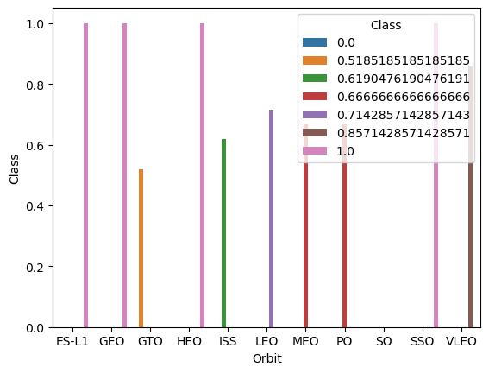
Success Rate vs. Orbit Type
From the bar chart, we see that ES-L1, GEO, HEO, and SSO orbits have the highest success rate.

Slide 21
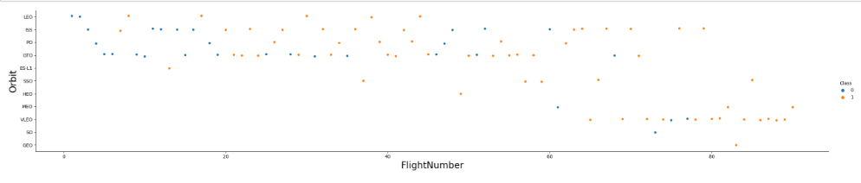
Flight Number vs. Orbit Type
From the scatter plot of Flight number vs. Orbit type, we see that LEO’s success rate is related to flight number, whereas GEO’s success rate seems to be independent of flight number.

Slide 22
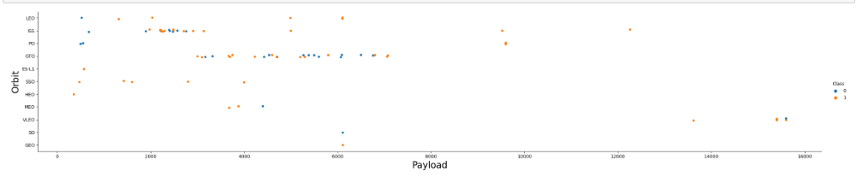
Payload vs. Orbit Type
We see that for heavier payloads, success rate increases for LEO, ISS and Polar orbits
There seems to be no observable relation between GTO orbit and payload mass

Slide 23
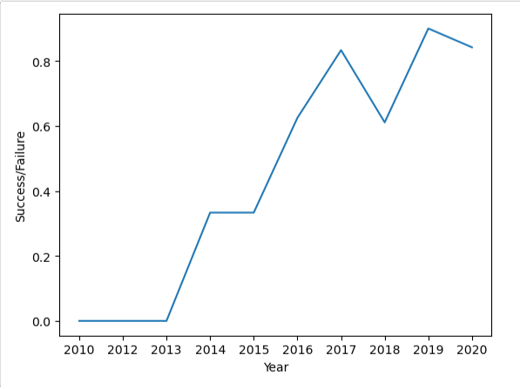
Launch Success Yearly Trend
The Line Chart shows that the success rate increased from 2013 to 2020 with minor fluctuations throughout the period.
We see a major plunge in the success rate for the year 2018.

Slide 24
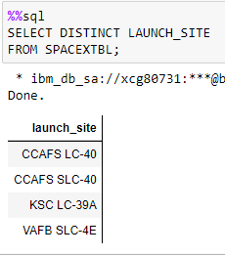
All Launch Site Names
We use the keyword DISTINCT to select unique launch sites from the table.

Slide 25
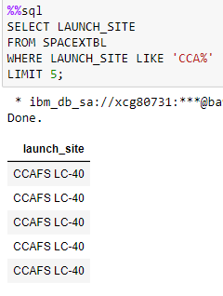
Launch Site Names Begin with 'CCA'
The keyword LIKE is used to specify that the launch site name begins with CCA.
The limit keyword is used to query only 5 records.

Slide 26
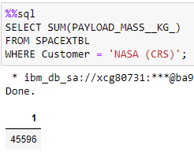
Total Payload Mass
The total payload mass for customer NASA (CSR) is 45,596 kg.
The function SUM is used to obtain the sum of payload mass.
The WHERE clause is used to specify that the customer should be NASA (CRS)

Slide 27
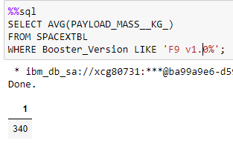
Average Payload Mass by F9 v1.0
• The average payload mass for rockets with booster version F9 v1.0 is 340 kg.
The function AVG is used to calculate the average of payload mass.
The WHERE clause is used to specify that the booster version should be F9 v1.0.

Slide 28
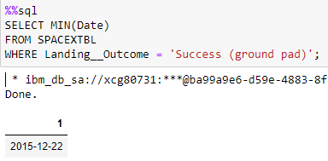
First Successful Ground Landing Date
The first successful ground landing occurred on 22 December 2015.
The function MIN is used to find the earliest date.
The WHERE clause is used to specify that the landing outcome is a successful ground pad landing.

Slide 29
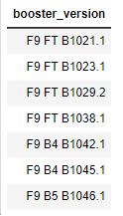
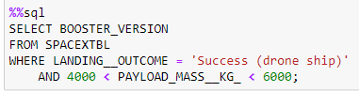
Successful Drone Ship Landing with Payload between 4000 and 6000
The names of boosters which have successfully landed on drone ship and had payload mass greater than 4000 but less than 6000 – F9 FT B1022, F9 FT B1026, F9 FT B1021.2, F9 FT B1031.2
The WHERE clause specifies that the landing was a success drone ship landing.
The AND clause adds another condition that the payload mass is between 4000 and 6000.

Slide 30
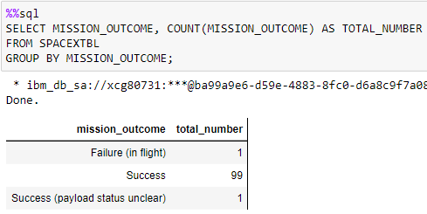
Total Number of Successful and Failure Mission Outcomes
Total Number of Successful Mission Outcomes – 99
Total Number of Failure Mission Outcomes - 1
The COUNT function gives the number of landings.
The LIKE clause is used to specify that the outcome is a success or a failure.

Slide 31
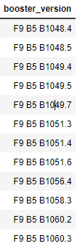
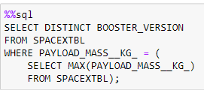
Boosters Carried Maximum Payload
The WHERE clause is used to specify that the booster version with the maximum payload mass is to be selected
The MAX function gives the maximum payload mass.

Slide 32
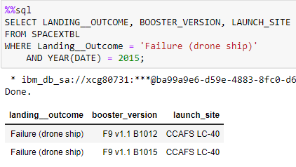
2015 Launch Records
The SUBSTR function selects the year out of the date.
The WHERE clause specifies that the date should be 2015 and the landing outcome should be a drone ship failure.

Slide 33
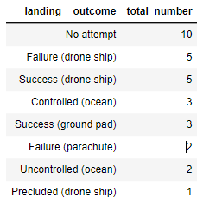
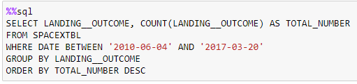
Rank Landing Outcomes Between 2010-06-04 and 2017-03-20
Rank the count of landing outcomes (such as Failure (drone ship) or Success (ground pad)) between the date 2010-06-04 and 2017-03-20, in descending order
The GROUP BY clause was used to group the landing outcomes and the order by clause was used to sort the grouped landing outcome in descending order

Slide 34

Section 3

Slide 35
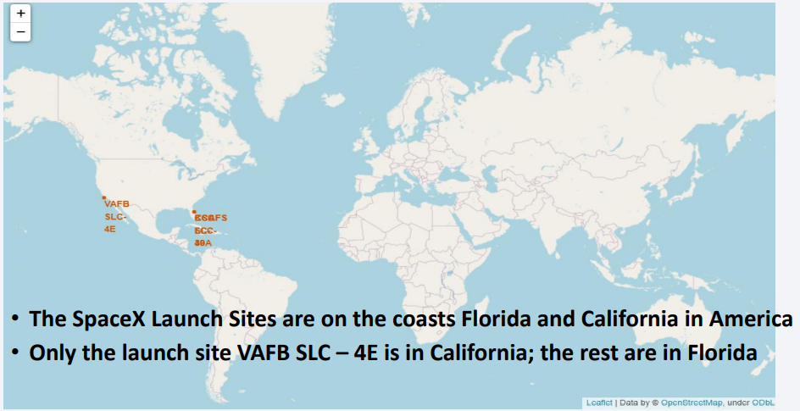
SpaceX Launch Sites on the Global Map

Slide 36
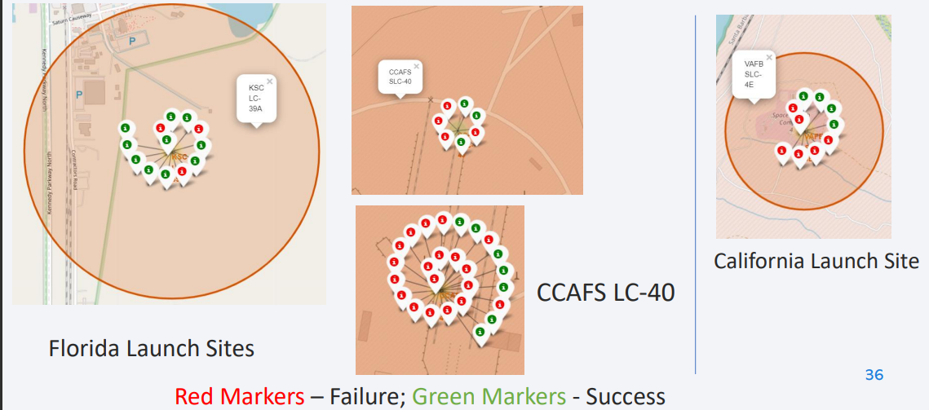
Success/Failed Launches for Each Launch Site
Replace <Folium map screenshot 2> title with an appropriate title
Explore the folium map and make a proper screenshot to show the color-labeled launch outcomes on the map
Explain the important elements and findings on the screenshot

Slide 37
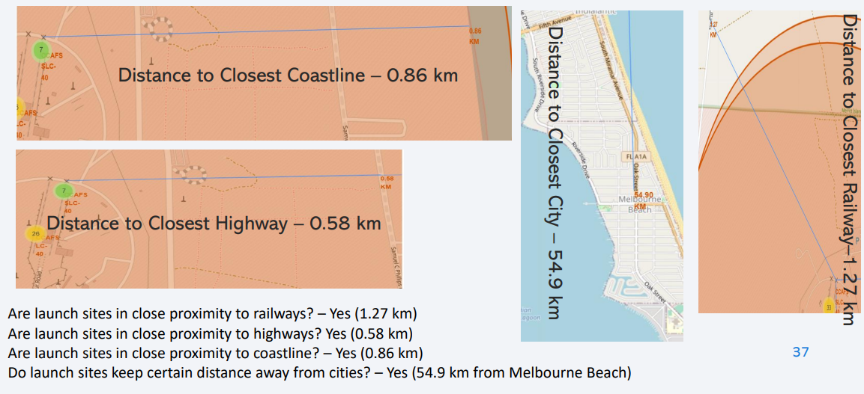
Launch Site Proximity From Landmarks

Slide 38

Section 4

Slide 39
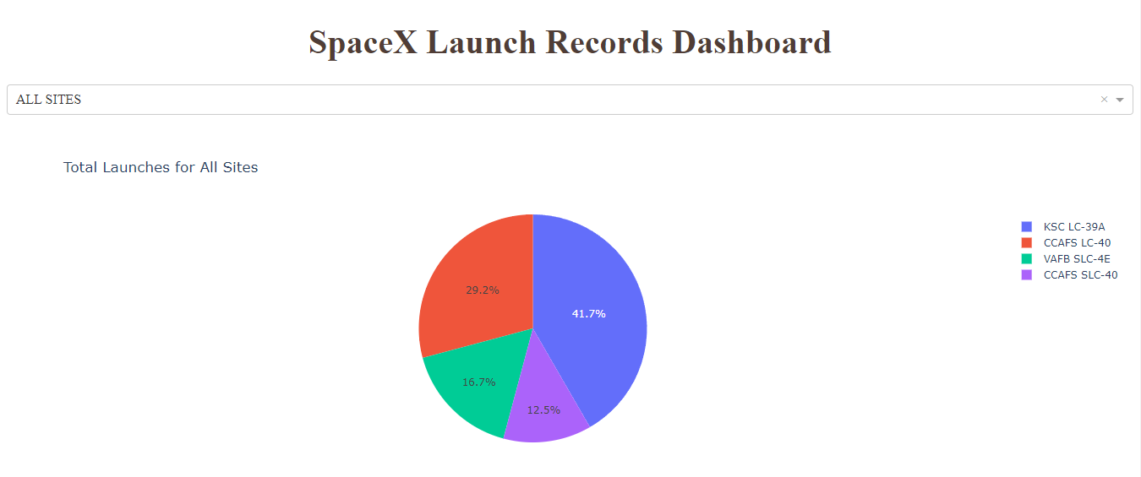
Pie Chart of Total Success Launches by all Site
Launch Site KDC LC-39 A has the Greatest Launch Success Rate

Slide 40
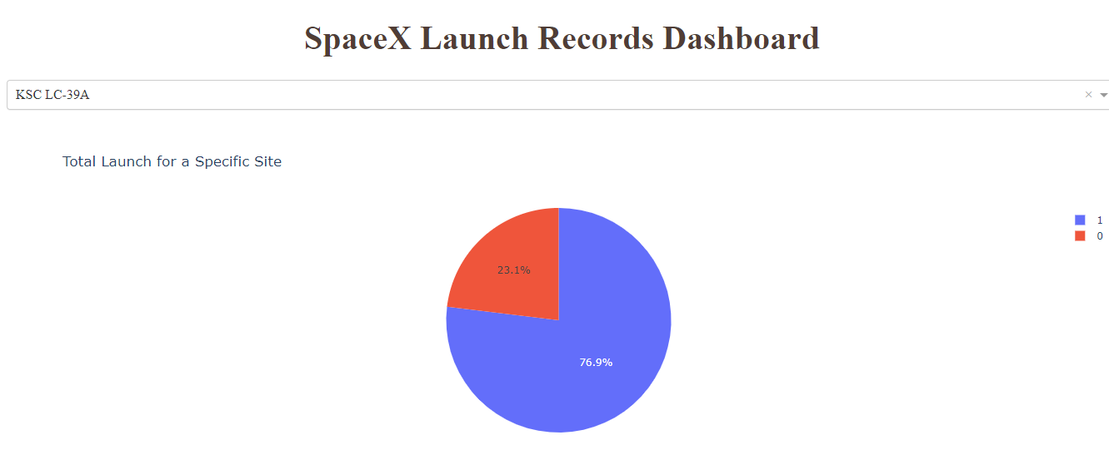
Pie Chart of Success/Failure Launch Rate of KDC LC-39 A
Replace <Dashboard screenshot 2> title with an appropriate title
Show the screenshot of the piechart for the launch site with highest launch success ratio
Explain the important elements and findings on the screenshot
We see that the launch site KSC LC-39A achieved a launch success rate of 76.9%

Slide 41
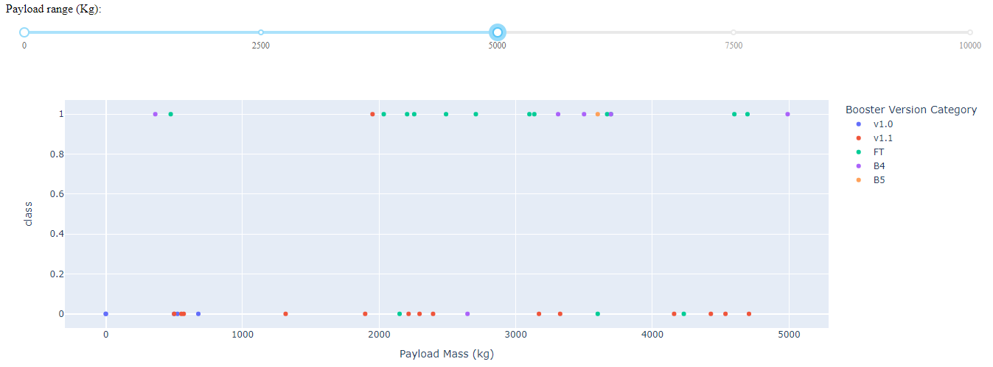
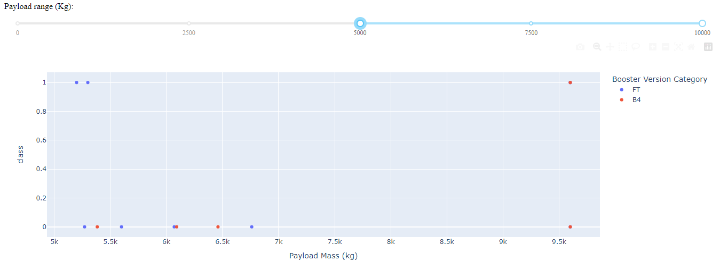
Payload comparation between 0-5000 KG and 5000-10000 kg
have the largest success rate, etc.

Slide 42

Section 5

Slide 43
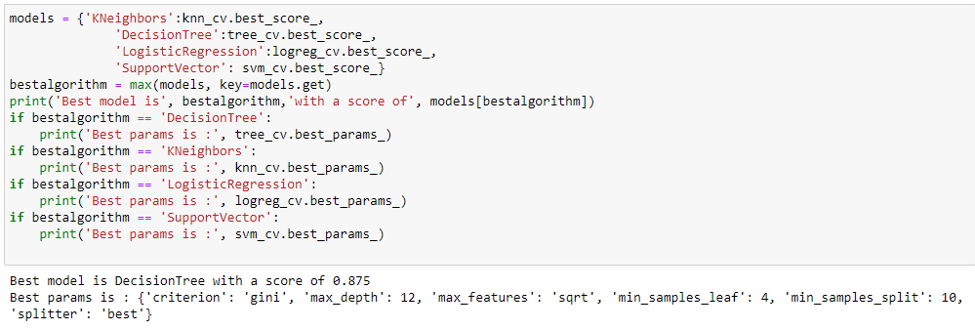
Classification Accuracy
We can see that the decision tree classifier has the highest classification accuracy of 0.875

Slide 44
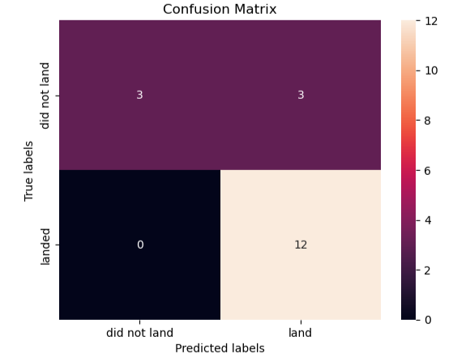
Confusion Matrix
Best Model – Decision Tree Classifier
The confusion matrix for the Decision Tree Classifier shows that the classifiers gives a high number of false positives, i.e., the rocket did not actually land successfully but the classifiers predicts that it landed successfully.

Slide 45
Conclusions
The greater the number of flights at a launch site, greater is the success rate at the launch site.
ES-L1, GEO, HEO, and SSO orbits have the highest success rate.
For heavier payloads, success rate increases for LEO, ISS and Polar orbits.
Launch success rate increased from 2013 to 2020 with minor fluctuations throughout the period.
Launch Site KDC LC-39 A has the Greatest Launch Success Rate
The Decision Tree Classifier is the best machine learning algorithm to predict SpaceX Falcon 9 rocket’s first stage will land successfully.

Slide 46
Appendix
GitHub Link from the repository utilized on this project with all code and notebooks developed: IBM-DataScienceFiles/Applied Data Science Capstone at main · Falkenus/IBM-DataScienceFiles (github.com)

Slide 47


